Slide 1
Embedded Database & Cloud Storage
We will start with Embedded Databases

Slide 2
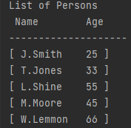
Creating an sqlite database
Want to create a database like this
Need to import sqlite3

Slide 3
import sqlite3
def createTable():
try:
cur.execute("CREATE TABLE Person(Name, Age)")
data = [ ("J.Smith", 25), ("T.Jones", 33), ("L.Shine", 55),
("M.Moore", 45), ("W.Lemmon", 66), ]
cur.executemany("INSERT INTO Person VALUES(?, ?)", data)
con.commit()
except:
print("Person Already Exists")
#-------------------------------------------
con = sqlite3.connect("tutorial.db")
cur = con.cursor()
createTable()
displayAll()

Slide 4
def displayAll():
cur.execute("select * from Person")
list = cur.fetchall()
print('\nList of Persons')
print(' Name Age')
print('--------------------')
for currentPerson in list:
print("[", currentPerson[0], "\t",
currentPerson[1], "]")
#-------------------------------------------
con = sqlite3.connect("tutorial.db")
cur = con.cursor()
createTable()
displayAll()

Slide 5
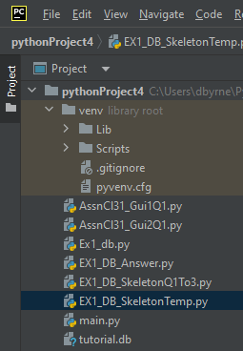
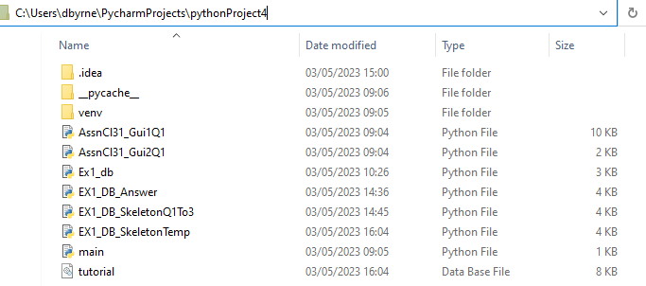
#con = sqlite3.connect("../../Downloads/tutorial.db")
con = sqlite3.connect("tutorial.db")
cur = con.cursor()
Created Database tutorial.db in current working
Directory if does not exist previously

Slide 6
N.B. Need to delete tutorial.db from here to rerun
with original data

Slide 7
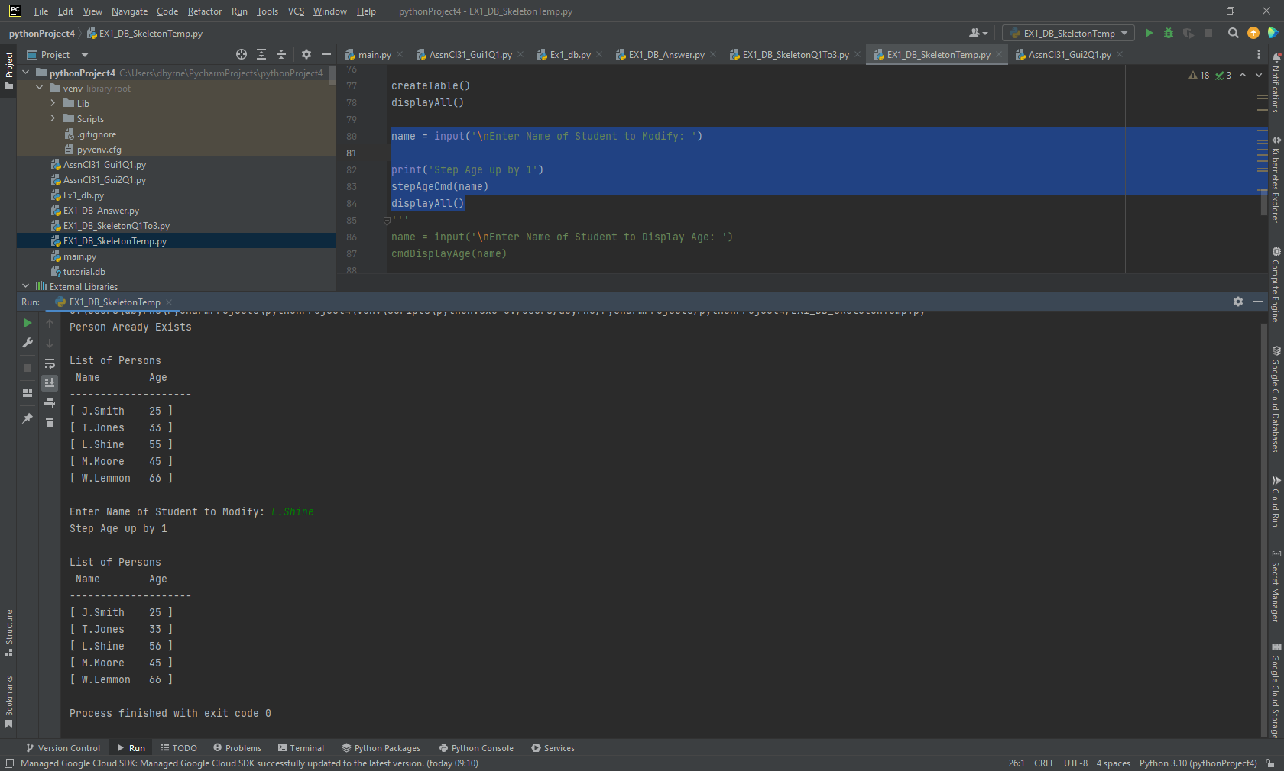
def stepAgeCmd(name):
try:
cur.execute("Update Person set Age=Age + 1
where Name = \'" + name + "\'")
con.commit()
except:
print(‘Error in Database')
#-------------------------------------------
con = sqlite3.connect("tutorial.db")
cur = con.cursor()
createTable()
displayAll()
name = input('\nEnter Name of Student: ')
print('Step Age up by 1')
stepAgeCmd(name)
displayAll()

Slide 8
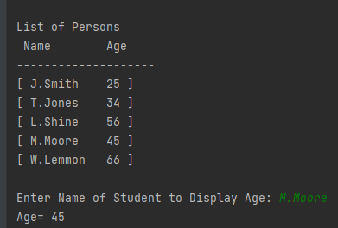
def cmdDisplayAge(name):
cur.execute("select * from Person where Name = " + "\'" + str(name) + "\'")
currentPerson = cur.fetchall()[0]
print("Age= " + str(currentPerson[1]))
#-------------------------------------------
displayAll()
name = input('\nEnter Name of Student : ')
cmdDisplayAge(name)

Slide 9
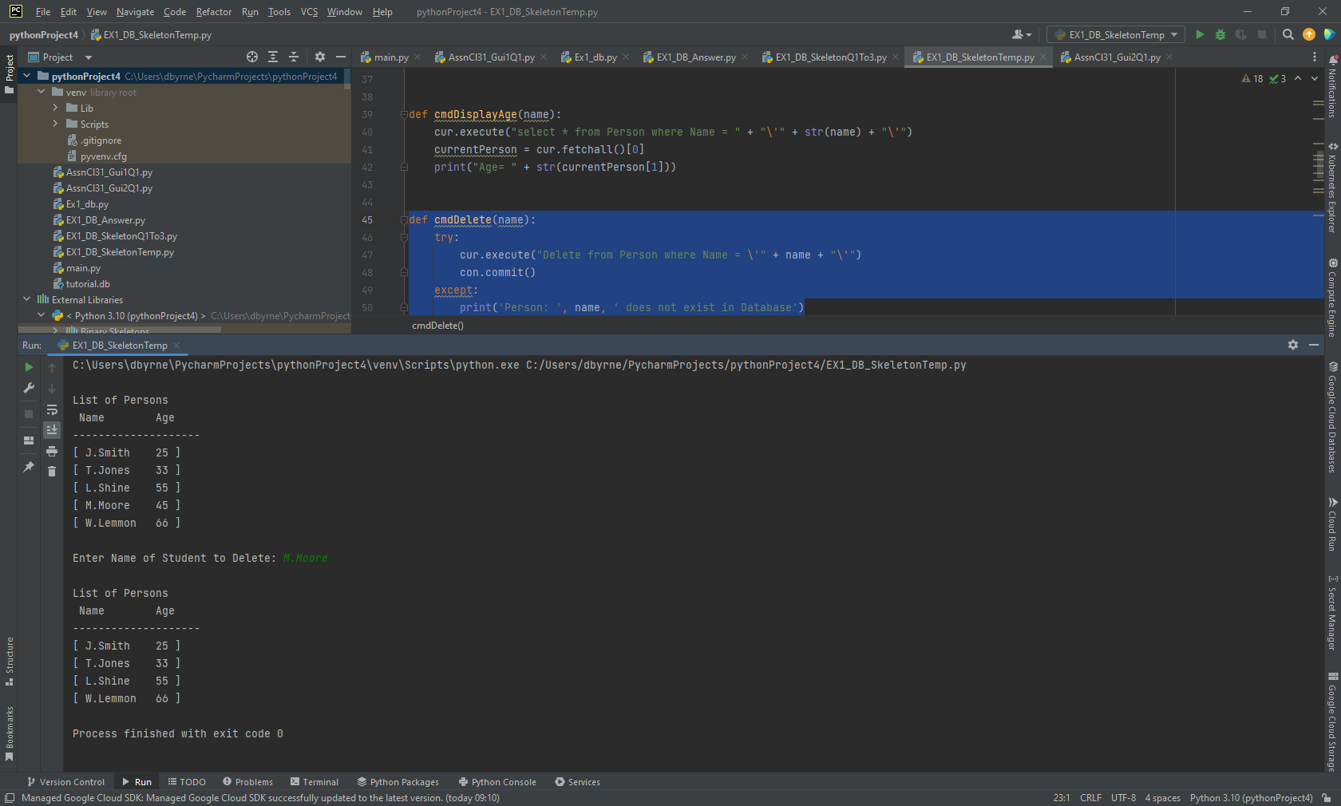
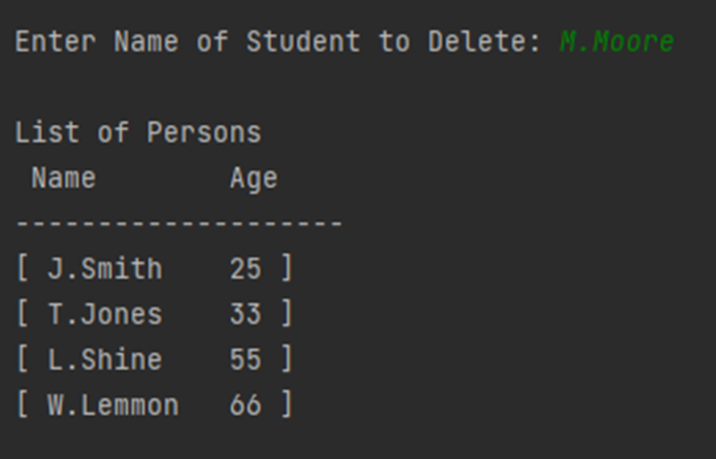
def cmdDelete(name):
try:
cur.execute("Delete from Person where Name = \’”
+ name + "\'")
con.commit()
except:
print('Person: ', name, ' does not exist in Database')
#-------------------------------------------
displayAll()
name = input('\nEnter Name of Student
to Delete: ')
cmdDelete(name)
displayAll()

Slide 10
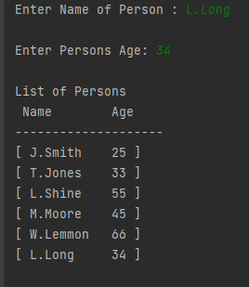
def insertCmd(newName, newAge):
try:
cur.execute("INSERT INTO PERSON VALUES(" + "\'" + newName
+ "\', " + str(newAge) + ")")
con.commit()
except:
print('Person does not exist in Database')
#-------------------------------------------
displayAll()
print(('\nInsering a new Person'))
name = input('\nEnter Name of Person : ')
age = int(input('\nEnter Persons Age: '))
insertCmd(name, age)
displayAll()

Slide 11
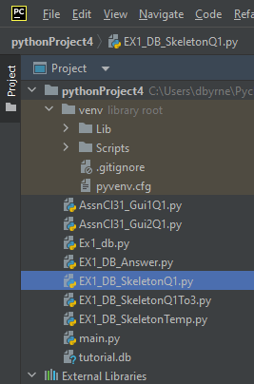
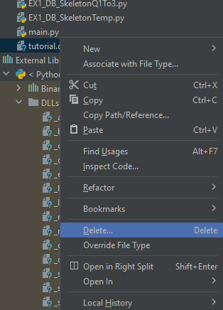
For These Questions Q1-Q3 Delete the Database First before you test
Right Click on
tutorial.db
then Delete

Slide 12
List of Persons
Name Age
--------------------
[ J.Smith 25 ]
[ T.Jones 33 ]
[ L.Shine 55 ]
[ M.Moore 45 ]
[ W.Lemmon 66 ]
Resetting Age to a new Value
Enter Name of Student : T.Jones
Enter New Age: 66
List of Persons
Name Age
--------------------------
[ J.Smith 25 ]
[ T.Jones 66 ]
[ L.Shine 55 ]
[ M.Moore 45 ]
[ W.Lemmon 66 ]
Q1 – Updating a given persons Age
def updateAgeCmd(name, newAge): :
#-------------------------------------------
#Q1 resetting Age
print('Resetting Age to a new Value')
name = input('\nEnter Name of Student: ')
age = int(input('\nEnter New Age: '))
updateAgeCmd(name, age)
displayAll()

Slide 13
--------------------
[ J.Smith 25 ]
[ T.Jones 33 ]
[ L.Shine 55 ]
[ M.Moore 45 ]
[ W.Lemmon 66 ]
Displaying details about People
in Given Age Range Inclusive
Enter Lower Age Limit: 30
Enter Upper Age Limit: 60
List of Persons between 30 and 60
Name Age
-------------------------
[ T.Jones 33 ]
[ L.Shine 55 ]
[ M.Moore 45 ]
Q2 – Display list of People within age limits
def displayInRangeCmd(lowerAge, upperAge)
#-------------------------------------------
# Q2 displaying people within Age Range
print('Displaying details about People in Given
Age Range Inclusive')
lowerAge = int(input('\nEnter Lower Age Limit: '))
upperAge = int(input('\nEnter Upper Age Limit: '))
displayInRangeCmd(lowerAge, upperAge)

Slide 14
Q3 – Deleting People younger than a given age
--------------------
[ J.Smith 25 ]
[ T.Jones 33 ]
[ L.Shine 55 ]
[ M.Moore 45 ]
[ W.Lemmon 66 ]
Deleting Everyone in the list younger
than a given age
Enter Lower Age Limit: 46
List of Persons
Name Age
--------------------------
[ L.Shine 55 ]
[ W.Lemmon 66 ]
def deleteAgeCmd(ageLimit):
#-------------------------------------------
# Q3 Deleting people younger than a given Value
print('Deleting Everyone in the list younger than
a given age')
ageLimit = int(input('\nEnter Lower Age Limit: '))
deleteAgeCmd(ageLimit)
displayAll()

Slide 15
--------------------
[ J.Smith 25 ]
[ T.Jones 33 ]
[ L.Shine 55 ]
[ M.Moore 45 ]
[ W.Lemmon 66 ]
Double the age of Everyone in list
under a given age:
Enter Lower Age Limit: 40
List of Persons
Name Age
--------------------
[ J.Smith 50 ]
[ T.Jones 66 ]
[ L.Shine 55 ]
[ M.Moore 45 ]
[ W.Lemmon 66 ]
Process finished with exit code 0
Q4 – Doubling Age of everyone older than a given age
def doubleAgeCmd(ageLimit)
#-------------------------------------------
# Q4 Double the age of Everyone under a given Age
print('Double the age of Everyone in list under a
given age: ')
ageLimit = int(input('\nEnter Lower Age Limit: '))
doubleAgeCmd(ageLimit)
displayAll()

Slide 16
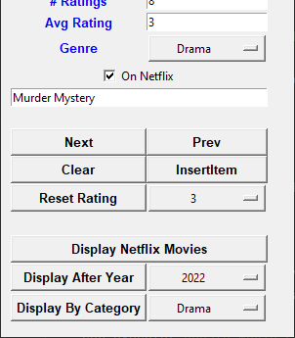
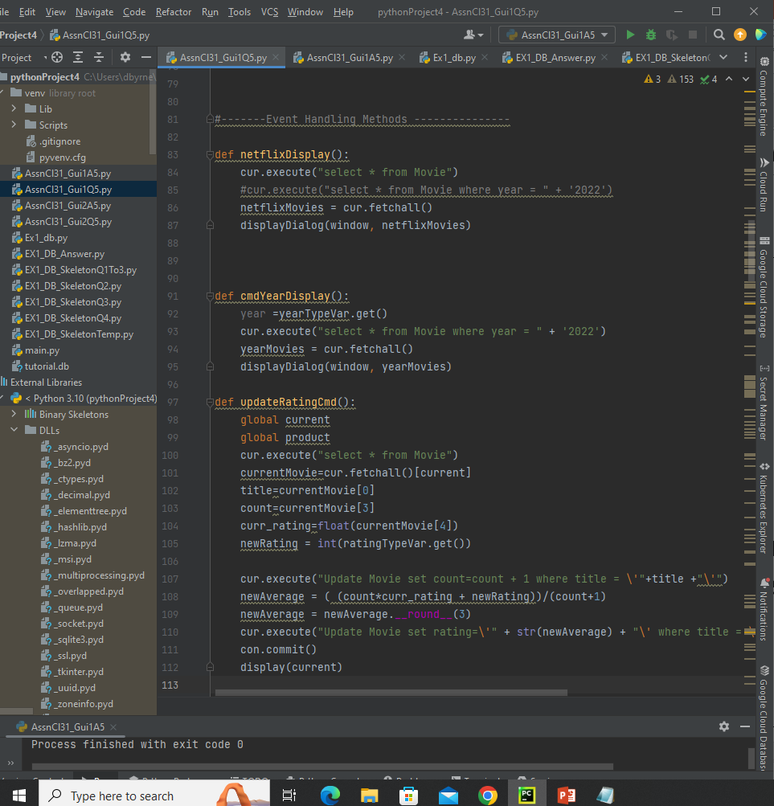
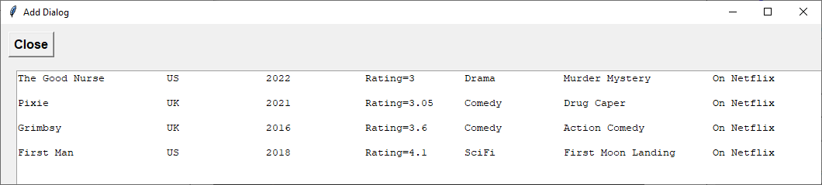
Q5 – Update 3 methods to behave as follows (A)
Displays only Netflix Films

Slide 17
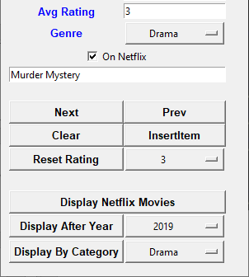
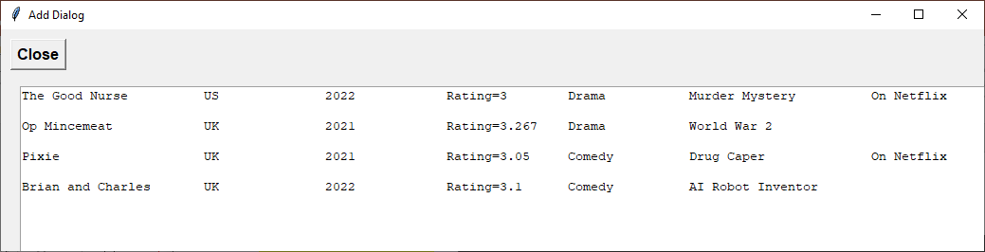
Q5 – Update 3 methods to behave as follows (B)
Displays only Films made after specified Year (2019)

Slide 18
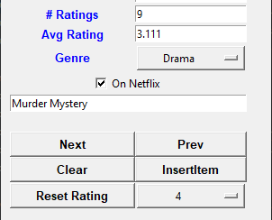

Q5 – Update 3 methods to behave as follows (C)
Currently Adds to Average Rating
Want to change it so it resets Rating to
Specified Value

